Slide 1

Rod Sowden
Aspire Europe Ltd
BPUG Workshops at Project Challenge are supported by:

Slide 2
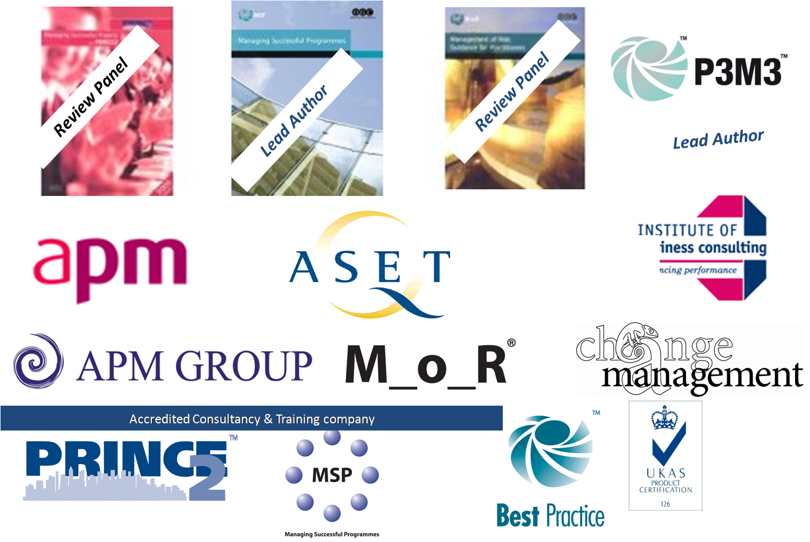
About Aspire Europe Ltd in the Vanguard
Notes:
Aspire Credentials
Been involved with Best Practice since 1999
Involved in all the OGC products developments
Lead authors for P3M3 and MSP
Accredited training organisation with APMG Group and ASET Exam bodies
ATO for MSP, PRINCE2, Principles of Change, Programme and Project Sponsorship
ACO for MoR, MSP, Programme and Project Mgt, Change Management, PRINCE2

Slide 3
OGC Best Practice
Common Glossary (updated)
Models
Guides
In Development
Updated
2008
Updated
2007
Updated
2007
Portfolio
,
Programme
,
and Project
OGC
Gateway™
M
_
o
_
R®
ITIL®
Portfolio
Programme and
Offices
Project
(
P
3
O®
)
Management
In Development
Maturity Model
(P3M3™)
Portfolio Guide
Updated
2007
MSP™ Programme Management
Refresh pending
Refresh underway
PRINCE
2
®
PRINCE2® Project Management
Maturity Model
Refresh underway
(
P
2
MM
)
Achieving Excellence in Construction

Slide 4

What on earth is P3M3 ?
P3
  Portfolio
  Programme
  Project
M3
  Management
  Maturity
  Model

Slide 5
Objectives & Scope
Restructure the model to improve accessibility and usability
Align the content of the model with the refreshed MSP, M_o_R, OGC Gateway and revised portfolio management guidance
Where appropriate align the content of the model with the emerging OGC procurement guidance
Develop a new introduction and revise supporting guidance on the use of the model and the self assessment questionnaire
The new standard should be able to be used thematically i.e. to establish the maturity of the organisation's processes such as business case, planning, reporting and so on. Now called Process Perspectives
A model covering portfolio, programme or project management maturity that can also deal with the component themes individually
An initial self-assessment questionnaire that can be downloaded via the internet
Consistent with original, i.e, investments in assessments will not be lost

Slide 6
Why use P3M3
Comparison is against a standard not other organisations
Helps organisations decide what standard they need to be achieve to meet their business needs
Focuses on the organisation maturity not individual projects (you can run successful initiatives without having high levels of maturity)
Objective assessment of strengths and weaknesses
Recognises achievements from investments
Justifies investment in programme and project management infrastructure
Plan for continual progression

Slide 7
Analyses the system
System
Process
People
Tools
Information
Need to be deployed and mature in balance

Slide 8
P3M3 Model
P3M3
Portfolio
Programme
Project
Management Control | Benefits Management | Finance Management | Stakeholder Management | Risk Management | Organisation Governance | Resources Management
Planning Skills and Capability Assurance, Information Management

Slide 9
Components
Level 5 Optimised
Level 4 Managed
Level 3 Defined
Level 2 Repeatable
Level 1 Awareness
Generic Attributes
apply to all Perspectives & Levels
Specific Attributes for each Process Perspective
Benefits Management

Slide 10
Attributes construction
Skills
Assurance
Level X
Info Management
Planning
Specific
Benefits
Management

Slide 11
Maturity Levels
Level | Description
1 – Aware | undocumented, basic vocabulary (not necessarily aligned or consistent), no guidelines and supporting documentation. Any system is ad-hoc and uncontrolled.
2 - Repeatable | Acknowledged approach, templates, ad-hoc training, islands of expertise, initiatives delivered in isolation, minimal evidence of continual improvement, focus may be on start up and initial documentation, evidence of heroes,
3 – Defined | Organisational wide consistency, process ownership, standards in place (e.g roles and responsibilities), processes defined with inputs and outputs, central control group, consistent use of tools, guidelines on how to do it,, capable staff,, evidence of Subject Matter Experts, perceptive approach to management, flexing
4 – Managed | Integration with Corporate governance and functions, accurate information, statistical analysis, competent & qualified staff, assurance in place, business capacity management, exec board level ownership, mentors, process management,
5 - Optimised | organisation, seamless and automatic, evidence based management, innovation
Notes:
Maturity levels are process and quality based

Slide 12
Perspectives
Perspective | Description
Management Control | Documented lifecycle, gated process, Vision, Blueprint, Outcomes, clear outputs, Issue management , Configuration management, change control, progress reporting, definition and design,
Benefits Management | Requirements, defined, tracking, ownership, business performance management, transition, exploitation
Financial Management | Costs, Business Case, approvals, tracking,
Stakeholder Management | Identification of stakeholders, analysis and management, communications planning, communications channels and media selection
Risk Management | Types, breadth, structure, process, rigor, techniques, interventions, opportunities and threats
Organisational Governance | Leadership, Direction, Alignment,, active engagement and ownership, balance of authority between functional and PPM Roles, reporting lines, legislative and policy compliance, control groups
Resource Management | Capacity, types, supply chain, estimation, control, allocation and deployment

Slide 13
Generic Attribute
Perspective | Description
Planning | Assesses the availability, use and value of the plans that exists for each perspective, levels of sophistication in their development and ownership
Information Management | Assesses the quality and accuracy of the information being used for decision making, how this information is stored and catalogued
Assurance | Assesses how effective and valuable the process of review, auditing and assurance are to the organisation, and how these are managed and exploited
Skills and capability | Assesses how the organisation develops the internal resources to increase their capability and potential over time

Slide 14
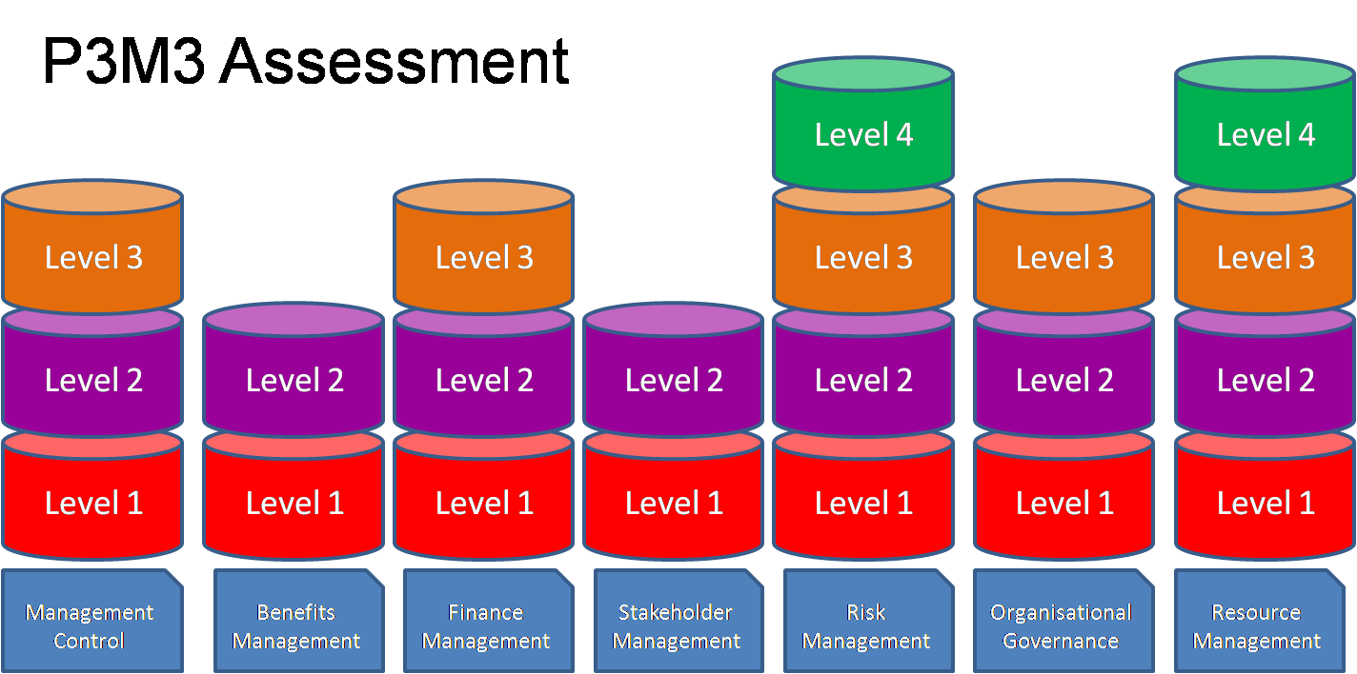
How a result might look:

Slide 15
Chose your target
Point of Optimum Balance
£
Money Spent
“Cost of Prevention”
“Cost of Winging it!”
Degree of Process / Formality

Slide 16

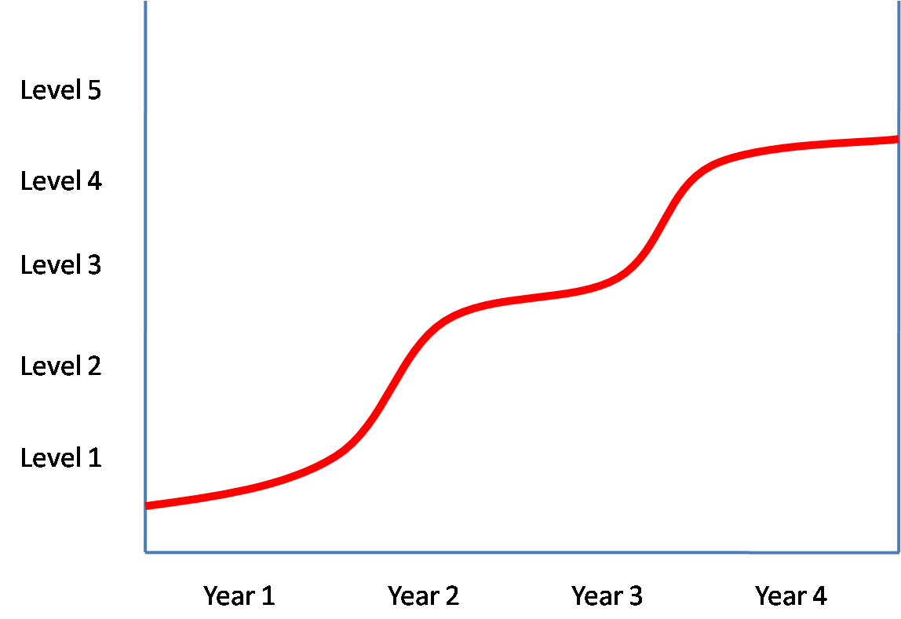
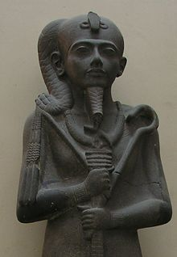
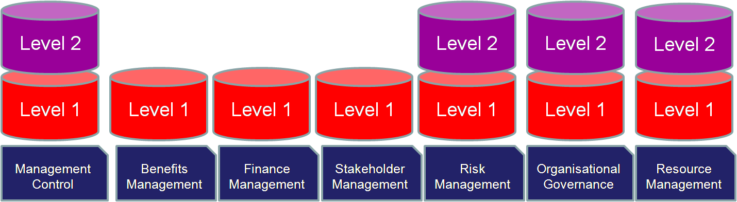

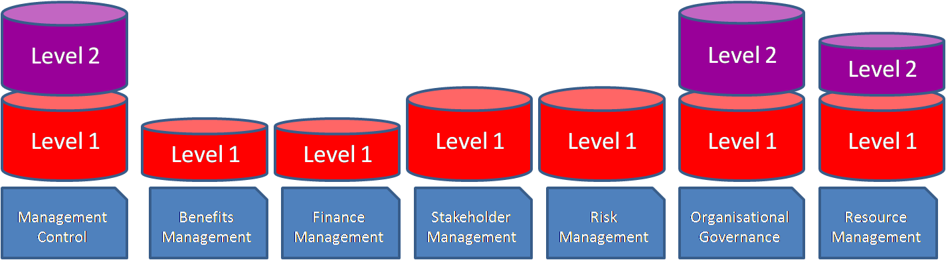
Using the Model
Where do we want to be?
What is our next target?
Identify strengths & weakness.
Set priorities
Take quick wins
Where are we now?

Slide 17
Case Studies
Public Utility Level 1 some 4
Starting point for MSP adoption
Acknowledge & contextualise work to date
Local Council Level 1 but mostly Level 2
10 years of PRINCE2 use and training
Government Agency
Level 2 some 3
Project Management embedded moving to MSP
Success due to strong team ethic, “can do” approach and co location
Significant Perspective gaps and some optimal
Improvement plan focused limited resources
Significant perspective gaps due to vanilla deployment
Lack of development or process improvement, held back by very poor templates
Held back by lack of processes, standards and documentation

Slide 18
How they integrate and overlap
Clients are tending to assess the lower model as preparation
PfM3
PgM3
PjM3
Models stand alone as well as interact

Slide 19
P3M3 Benefits to your organisation
Increased
Success
Avoid duplication
Avoidance of wasteful investment
Justification of continued investment
Systematic
improvement

Slide 20
Aspire Europe Ltd P3M3 support
OGC Self Assessment
Facilitated Self Assessment (3 to 4 days)
Registered Consultant led (10 days)
Certified by the APM Group
P3M3 Assessor and Analyst courses in conjunction with Outperform Ltd

Slide 21

Any questions – feel free to pop over and see us
Rod Sowden
www.aspireeurope.com

Slide 22
Best Practice User Group™ aims to be the official user group of choice for programmes, projects and risks.
Our mission: To help users adopt, use, share and shape the application of OGC PPM Products
www.usergroup.org.uk
0845 0548038
admin@usergroup.org.uk

