Slide 1
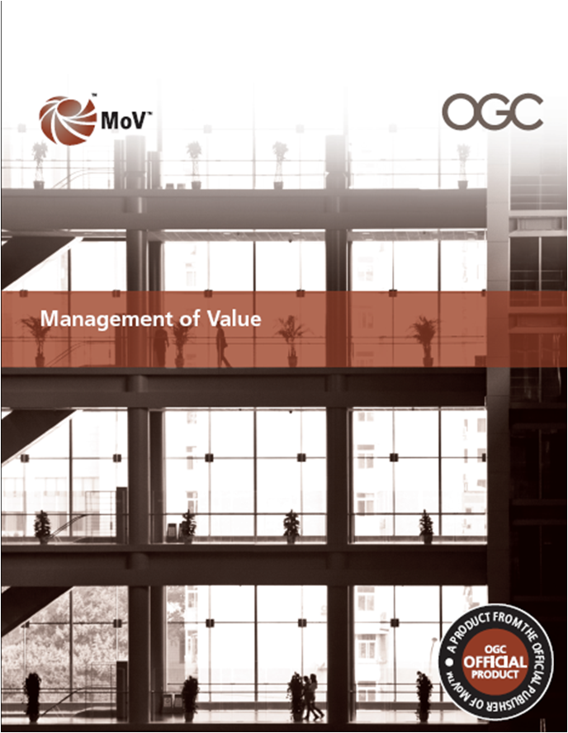
Launch of Management of Value (MoV™)

Slide 2
Agenda
Opening comments and domestics
Introduction by David Pitchford
Overview briefing – Michael Dallas
Institute of Value Management perspective – Michael Graham
Q&A
Extended question time and networking

Slide 3
Introduction
David Pitchford
Executive Director
Major Projects Directorate
Cabinet Office

Slide 4
Overview of Management of Value (MoV)
Michael Dallas MA (Cantab), MICE, FIVM, MAPM
Director
APM Group Ltd
Notes:
My name is Michael Dallas, I am a director of APMG Ltd and I have been practicing Value Management for over twenty years.
As lead Author of the OGC Best practice guide Management of Value, MoV, I am pleased to present this overview of the Guide and how it relates to other Best Practice guides for the Portfolio, Programme and Project Management community
20secs

Slide 5
Why?
Feasibility study 2008 confirmed a gap in the PPM suite of publications
No publications available that cover application at Portfolio, Programme, Project and Operational levels in Public and Private sectors
Enhances many of the methods available in other publications such as PRINCE2 and MSP
Notes:
This presentation will cover:
Context of MoV with other Best Practice Guides
Its Purpose
What it and why it is important
Where and when it should be used
Underlying Principles
Key Processes
Techniques that are unique to MoV
A link to other commonly used techniques
An approach to implementation
Responding to external and internal influences
A resume of other parts to the guide
Fit with other Best Practice publications
That’s a lot to fit into 20 minutes so I’d better get on with it!
45

Slide 6
Why MoV?
MoV enhances competitiveness, productivity and profitability
  Maximising return on investments
  Making optimum use of resources
  Providing value for money for customers
  Streamlining production and delivery of services
  Eliminating wasteful practices
It also provides a way to
  Deliver cost savings with minimum impact on essential quality of products and services
  Cut non essential projects or services
Notes:
MoV is a vital tool in remaining competitive, maximising productivity and improving profitability in times of plenty as well as times of austerity.
It maximises return on investments, makes better use of potentially scarce resources, delivering value for money for customers
MoV may be used to improve efficiency in the delivery of services and eliminating wasteful practices
When it is necessary to to make cost reductions, MoV provides a way to do this with minimum the impact on essential quality.
It also provides objective methods to stop those projects and services that add least value.
Organisations must always endeavour to maximise the return on their investments, eliminate waste and make optimum use of resources
MoV provides an effective process to contribute to all the above aims.
45 secs

Slide 7
“We (must) move … to taking the decisions necessary to equip Britain for long-term success. That means prioritizing things like better schools … and infrastructure improvements so that we can build a sustainable economy for the future.”
The Rt. Hon David Cameron, August 2010

Slide 8
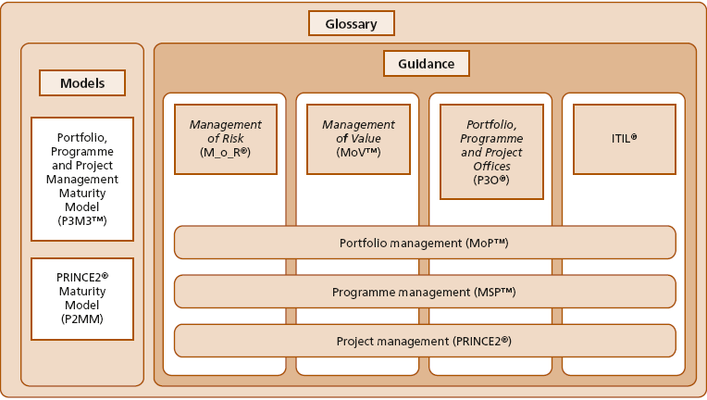
Context
Complements other Best Management Practice products
Notes:
MoV joins a suite of products aimed at encouraging the use of best practice in the management of Portfolios, Programmes and Projects.
MoV may also be applied to operations
MoV it is applicable across portfolios, programmes and projects and should be integrated with them rather than applied as a bolt on extra.
I will be describing how MoV contributes to these other products at the end of this presentation
30secs

Slide 9
How does MoV maximise Value?
Value defined as ratio between satisfaction of needs (benefits) and use of resources (expenditure)
Reconciling the needs and views of different stakeholders
Balancing the use of resources to suit priorities
Balancing the overall benefits realised with the use of resources by optimising the value for money ratio
Notes:
MoV is about maximising value while taking account of differing stakeholders needs and an organisation’s value priorities.
To maximise value it is necessary to reconcile the needs of all key stakeholders
Differing organisations will have different priorities on their use of resources
And it is essential to maximise the ratio of satisfaction of needs (benefits delivered) with the use of resources
MoV is all about maximising value in line with the programme and project objectives and the key stakeholder requirements. It is not simply about minimising costs.
MoV is a collective term that embraces many processes that are aimed at maximising value which are explained or signposted within this guide.
45 secs

Slide 10
Where and when should I use it?
MoV is applicable to hard and soft projects in all sectors
More opportunities early in project lifecycle
Notes:
MoV is applicable to hard projects like Construction, where there is a physical output that can be seen and touched, as well as soft projects, for example, transformational change in an organisation.
The earlier MoV is applied in a project, the greater are the opportunities to add value.
Early in a project, fewer decisions will have been taken and signed off. There is, therefore, much greater freedom to make changes to improve value.
The further a project has progressed the more resources will have been consumed. A major change at a late stage may involve abandoning something into which a lot of resource has been sunk and cannot be recovered.
A third factor will be the willingness of the project contributors to accept change. For example. if a contributor is working to a fixed fee they will be very unwilling to make changes even if value is increased. In a transformational change project, people may be unwilling to change the ways that they have always worked.
70 secs

Slide 11
MoV Principles
Based on seven sound principles
  Align with organisational objectives
  Focus on functions and required outcomes
  Balance the variables to maximise value
  Apply throughout the investment decision
  Tailor to suit the subject
  Learn from experience and improve
  Assign clear roles and responsibilities and build a supportive culture
Notes:
MoV is based on seven principles. If you are not using these principles you are not using it properly
It needs to be fully aligned with the organisation’s strategic objectives
It should focus on the functions that are necessary and sufficient in order to deliver the required programme and project outcomes
It should engage with all key stakeholders, reconciling their differing needs to deliver a balance of benefits acceptable to all
It should be applied through all stages of the total lifecycle of the programme or project, not just at the outset.
It must be tailored to suit the subject project’s environment, size, complexity, criticality and risk
MoV applications should encourage learning from experience and improvement
The application of MoV needs to be supported by effective management, delivered through clearly defined roles and responsibilities and a supportive, value-adding culture
75 secs

Slide 12
MoV Processes
Underpinned by seven fundamental processes
  Frame the programme or project.
  Gather information
  Analyse information
  Process information
  Evaluate and select
  Develop Value Improving Proposals
  Implement and share outputs
Notes:
There are seven fundamental groups of MoV Processes:
Frame the programme or project involves gaining an understanding of the objectives and issues that need to be addressed
Gather information includes procuring information relating to the project, the expectations from the study, identifying suitable team members, understanding stakeholders needs and other project related information
This is then analysed to form useful input to the MoV Study
The team then use the information to develop ways in which to improve value
They then select those that have most potential for practical and beneficial implementation
They work up the selected ideas into fully developed value improving proposals for decision and implementation
All the above effort will be wasted if there is not a clear plan for implementing the outputs and monitoring their effective delivery.
75secs

Slide 13
The value cascade
Relates products and objectives to organizational goals

Slide 14
Key techniques – MoV Specific
Function Analysis is a key technique of MoV
Analyses what things do rather than what they are
Defers seeking improvement until functions are visibly mapped
Opens the door to innovative value improving proposals
Two main approaches:
  Function Analysis System Technique (FAST)
  Value Trees
Both use How/Why logic
Notes:
There are two groups of techniques that are used in MoV
The first group comprises those that are used exclusively with MoV
Arguably the most important of this group is Function Analysis – analysing what things do rather than what they are
Function analysis provides the key to gaining a better understanding of a programme or project, making decisions based on value and generating innovative proposals to improve value.
There are several types of Function Analysis. All are based on the same logic: Asking how something is done and, conversely, asking why it is done.
This slide shows the Function Analysis System Technique or FAST diagram that is widely used in many circumstances. In Portfolios, Programmes, Projects and operational MoV studies the Customer FAST, relating to customer needs is the most commonly used.
75secs

Slide 15
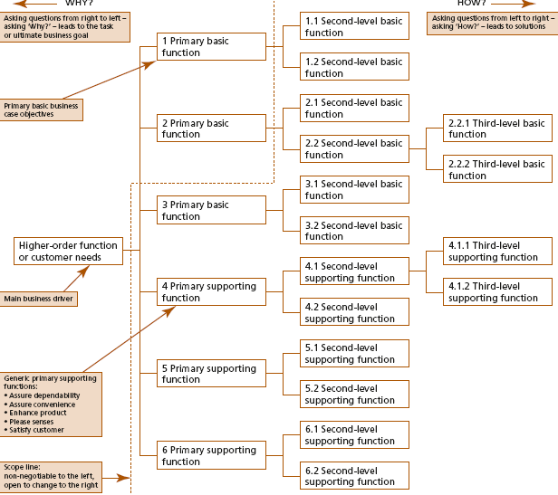
A customer FAST diagram
Shows the relationship of functions and their hierarchy

Slide 16
A Value Tree
Defines value drivers
Shows what designs need to address
Informs the brief
Notes:
This slide shows a simplified Value Tree for a Hospital
Taking the first Value Driver, Treat General and \Acute Care patients, the design team need to consider, amongst other things, How they will receive outpatients and how they will enhance the quality of inpatient environment. The Design team’s response to these considerations was to design a large outpatient reception area and provide lots of natural ventilation and daylight.
Not only does the Value Tree provide an excellent description of the project, thus informing the project brief, but it provides the basis for generating innovative alternative solutions to improve value.
45 secs

Slide 17
A Value Profile
Articulates an organization’s or stakeholders’ priorities
Notes:
By prioritising the Value Drivers to align with the Project Sponsor’s or owner’s and end users’ priorities one generates a Value Profile.
At Portfolio level this same technique provides a method of articulating an organisation’s value priorities.
At project level it makes it possible to redistribute the use of resources to where they will add most value, whilst retaining other essential features.
30 secs

Slide 18
A Value Index
Indicates how well a project satisfies an organization’s or key stakeholders’ needs
Does not indicate value for money
Notes:
The Value Profile described in the previous slide. provides the basis for generating a Value Index.
By assessing performance against each value Driver using agreed metrics, this indicates how well a project satisfies key stakeholders’ needs
It does not, however, indicate if it is value for money.
45 secs

Slide 19
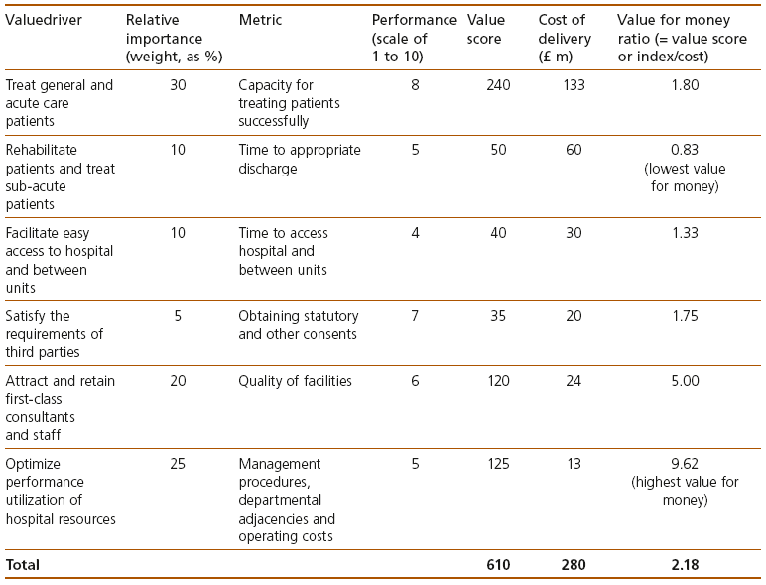
Demonstrates Value for Money
The Value Ratio
Notes:
Taking this progression one stage further, by dividing the value scores by the cost of delivering each Value Driver, one can calculate the Value for Money ratio for each individual Value Driver and also for the project as a whole. The higher the value for money ratio, the greater is the value for money.
Remember this measures value for money for both monetary and non monetary benefits.
30secs

Slide 20
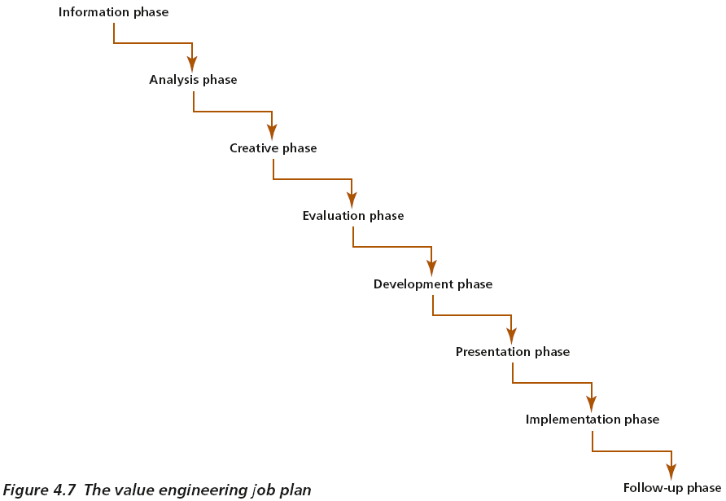
Value Engineering
Value engineering (VE) is a method that brings many of the above processes together into one coordinated study.
It remains the most commonly used method within the MoV family
Notes:
Value Engineering is the original technique from which MoV has evolved. It has been used in almost all sectors of industry and commerce to great effect for about 50 years. Value Engineering is still one of the most common techniques in use today.
Value Engineering is applied to an existing product, process or design to improve value.
It uses the same principles as described earlier.
The details may vary between different organisations but it comprises essentially eight steps:
Gathering information
Analysing it
Using it to generate innovative ideas to improve value
Evaluating these and selecting those that warrant further development
Developing selected ideas into full Value Improving Proposals
Presenting these to management to build implementation decisions
Implementing the changes
Monitoring progress to ensure the expected benefits are realised.
70secs

Slide 21
Techniques commonly used in MoV
Apply to and reflect the MoV Processes
  Analysing information
  Generating innovative ideas
  Selecting options
  Evaluating the merits of and selecting ideas
  Building decisions to implement Value Improving Proposals
  Implementing VIPs and realising benefits
Linked to descriptions of these and other techniques may be found at the TSO On Line Repository for MoV at:
http://www.best-managementpractice.com
Notes:
There many other techniques which may be used in the application of MoV. Details of many of these may be found in the MoV Guide and on the TSO on line repository for MoV
20secs

Slide 22
Approach to implementation
Explains the purpose of following the processes
Sets out a generic approach around which to structure a MoV Study

Slide 23
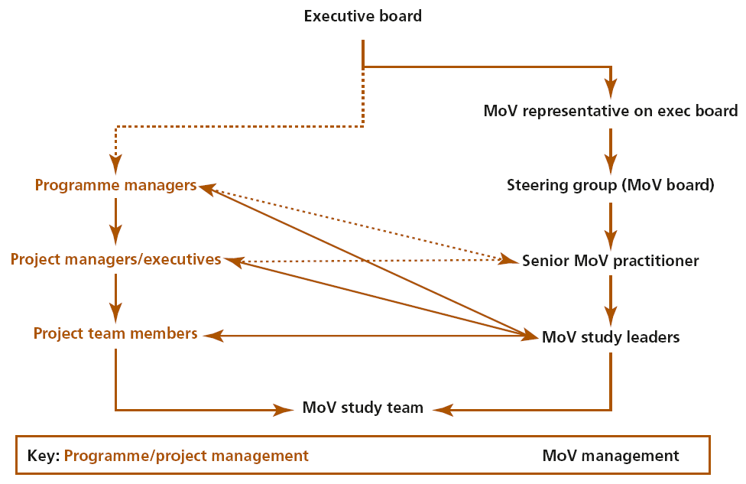
Possible relationship between Project management and an Organization’s management
Relationships

Slide 24
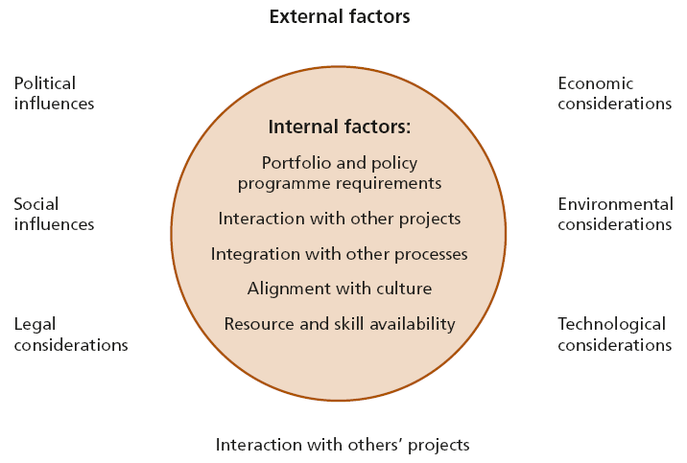
Interacting with the environment

Slide 25
Embedding into an organization
Possible Organizational management structure
Must be proportionate to the need

Slide 26
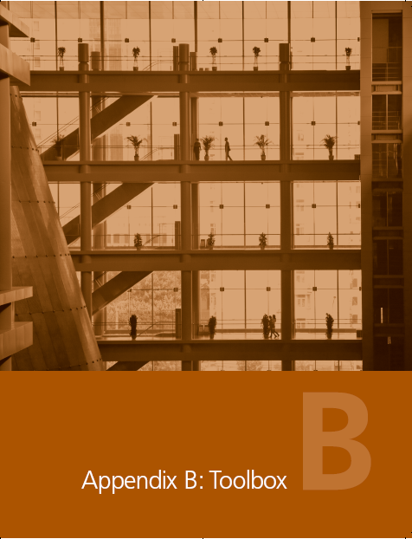
Appendices

Slide 27
Executive Guide to Value Management
To inspire senior management to adopt and use MoV
Notes:
The full MoV guide contains guidance on implementing MoV, a chapter relating to the environment within which MoV is applied and how to respond to external influences
There is a chapter on embedding the process into an organisation
Appendices include document checklists, a toolbox of commonly used techniques, how to undertake a health check to assess how well your organisation is using MoV and a section of organisational maturity and individual competence.
There is also a pocket book sized Executive guide to Value management, aimed to inspire senior managers to use MoV within their organisations
50

Slide 28
Foundation level qualification
Available to ATOs from today

Slide 29
Some challenges ahead
But, when the cancellation of entire programmes is needed, deciding what to cut is often far from scientific
Cutting costs arbitrarily is easy. It is less easy is to cut costs in a way that will safeguard the long term economic recovery
In total, the government is looking for £1.7bn savings from delaying and stopping projects
The toughest public spending cuts in a generation
There is a 30% affordability gap

Slide 30
…and some successes in the past
A study into the development of an international-class sports stadium involved a team of about 20 people for a month …. The overall reduction in costs in the accepted value-improving proposals was US$200 m, representing a return on the total cost of the study of 333:1.
Value Management helped a hospital to recognize that its pharmacy’s function was not so much ‘dispensing drugs’ as ‘managing medication’. This was relevant to the whole hospital, not only the pharmacy. Whereas the pharmacy cost around £2 m per year to run, it influenced broader hospital costs of around £19 m, enabling far greater savings.
And many more in the guide...

Slide 31
Conclusion
In short, MoV provides a unique, proven and economical way to maximise value for organisations across portfolios, programmes, projects and operations
Notes:
I hope you have enjoyed this presentation and that it has given you an insight into what MoV is and how it will benefit your organisation
If you require further information, please visit the APM Group’s Website at www.ampgroup.co.uk
Thank you
20 secs
Total 1110 secs = 18.5 mins

Slide 32
IVM Perspective
Michael Graham
Chair of the Institute of Value Management Certification Board

Slide 33
Q&A SESSION

Slide 34
EXTENDED QUESTION TIME

