Slide 1
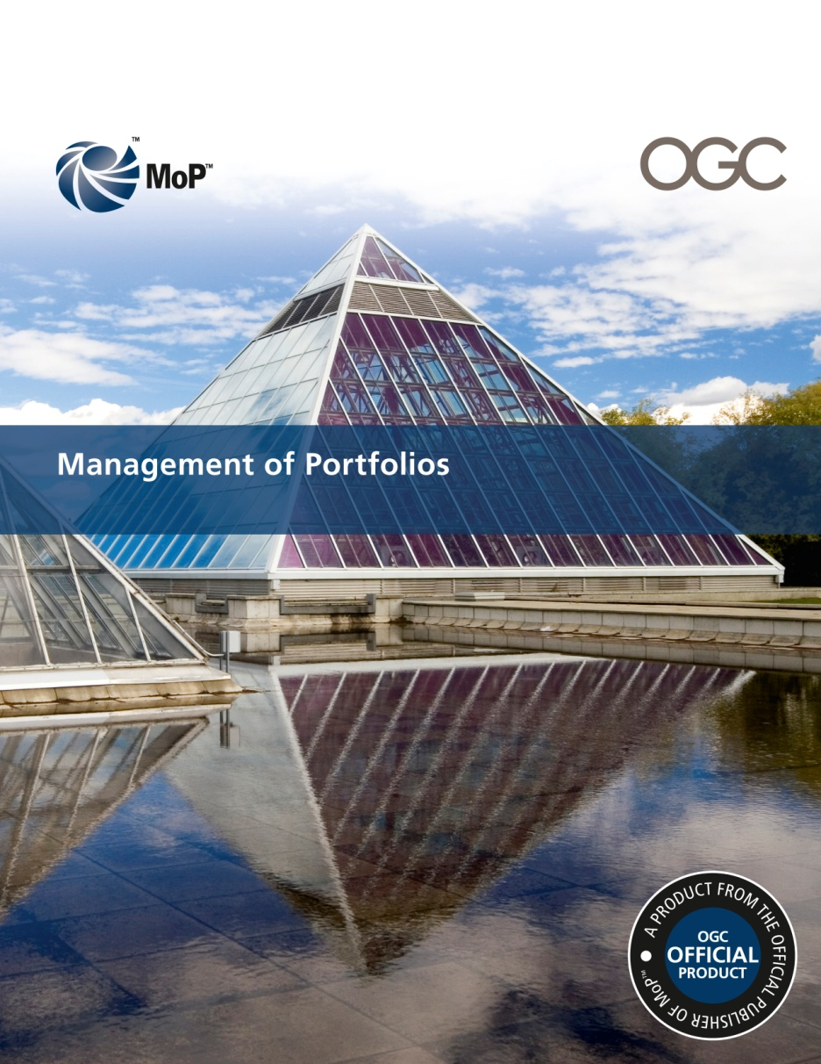
Management of Portfolios (MoP™)
Overview

Slide 2
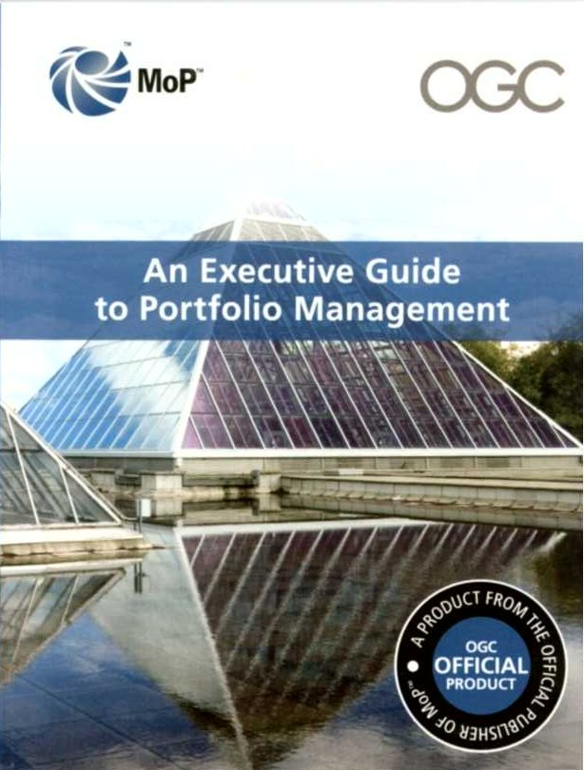
Executive Guide - Published June 2010
“Many times small thing are…well…small. This
small, new, OGC guide, however, is right on target
for executive education in portfolio management.”
“Executives in organizations that are considering an
implementation and use of project portfolio
management (or who are not satisfied with the
current use of that discipline) should get and use
this publication as a “concept document”, and
as a communication mechanism, for input and
iterative refinement to a discussion of both the
value and impact potential to its adoption.”
Gartner Short Standard 07/08/10 Michael Hanford
UNCLASSIFIED
Notes:
UNCLASSIFIED
2

Slide 3
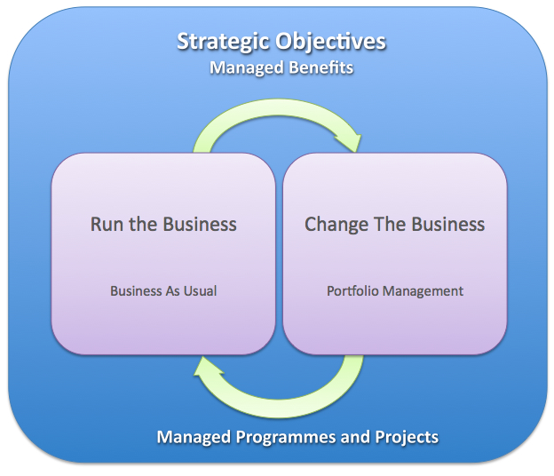
MoP - What are we talking about?
Portfolio:
The totality of an organization’s
investment (or segment thereof)
in the changes required to
achieve its strategic objectives.
Portfolio Management:
Portfolio Management is a co-
ordinated collection of strategic
processes and decisions that
together enable the most effective
balance of organizational change
and Business As Usual.
UNCLASSIFIED
Notes:
UNCLASSIFIED
3

Slide 4
MoP - Where does it fit?
© Crown Copyright 2011 Reproduced with permission from OGC
M_o_R® is a Registered Trade Marks of the Office of Government Commerce in the United Kingdom and other countries
PRINCE2® is a Registered Trade Marks of the Office of Government Commerce in the United Kingdom and other countries
MSP® is a Registered Trade Marks of the Office of Government Commerce in the United Kingdom and other countries
ITIL® is a Registered Trade Marks of the Office of Government Commerce in the United Kingdom and other countries
P3M3® is a Registered Trade Marks of the Office of Government Commerce in the United Kingdom and other countries
P3O® is a Registered Trade Mark of the Office of Government Commerce
MoP™ is a Trade Marks of the Office of Government Commerce in the United Kingdom and other countries
MoV™ is a Trade Marks of the Office of Government Commerce in the United Kingdom and other countries
Notes:
4

Slide 5
MoP - The Target Audience
Anyone with an interest, and/or role, in delivering programmes and projects, and organizational strategy from inception to delivery. This includes:
Members of Management Boards and Directors of Change;
Senior Responsible Owners (SROs);
Portfolio, Programme, Project, Business Change and Benefits Managers;
Business Case writers and Project appraisers; and
Those in other functions/departments with a role in delivering strategic objectives.

Slide 6
MoP - Main contents
An overview of Portfolio Management
The Principles upon which successful approaches to Portfolio Management are built
Descriptions of the Practices contained within the two Portfolio Management cycles
Role Descriptions and key Portfolio Documentation
Real life examples of Portfolio Management

Slide 7
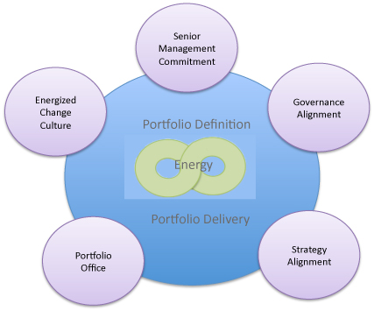
MoP - Portfolio Management Model
5 Principles
2 cycles
© Crown Copyright 2011 Reproduced with permission from OGC

Slide 8
MoP – Cycles & Practices
Doing the ‘right’ things
Doing things ‘right’
Portfolio Definition
Portfolio Delivery
Benefits Management
Categorize
Understand
Financial Management
Management Control
Organizational Energy
Risk Management
Prioritize
Resource Management
Stakeholder Engagement
Balance
Plan
Organisational Governance
© Crown Copyright 2011 Reproduced with permission from OGC
Notes:
8

Slide 9
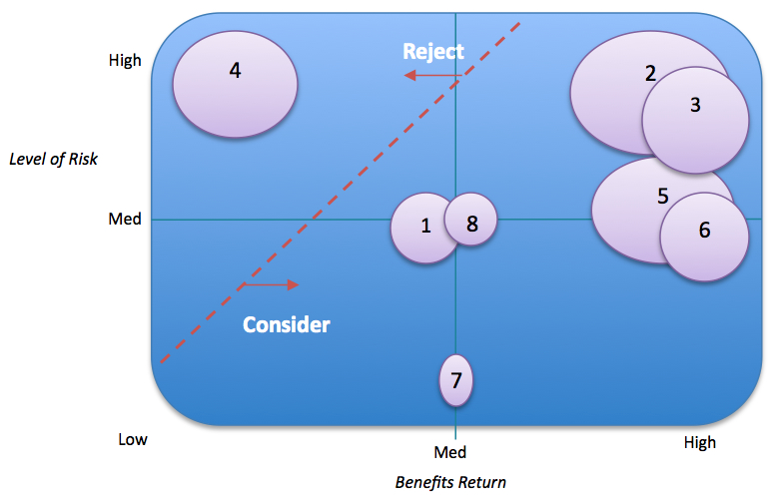
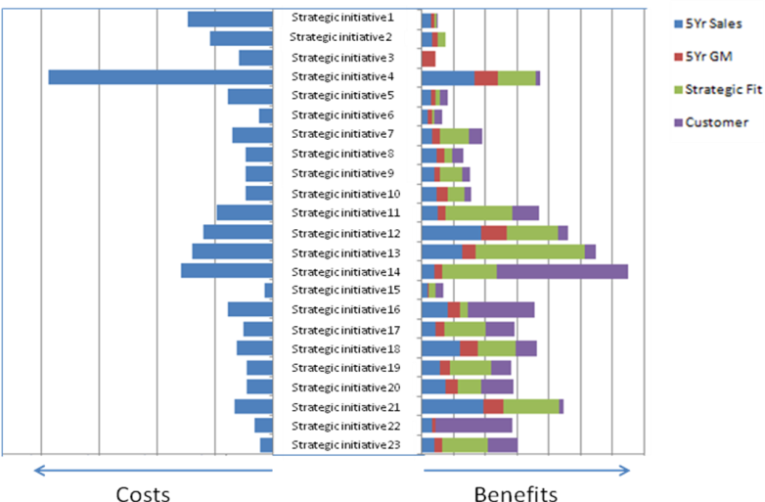
MoP - Tools and techniques

Slide 10
Benefits of Portfolio Management
Improved strategic contribution - more of the ‘right’ projects are undertaken
Removal of redundant, duplicate and low value adding projects
More effective implementation of projects and programmes
More efficient utilization of scarce resources including skilled project managers
Greater benefits realization
Improved accountability and corporate governance.

Slide 11
MoP – The next steps
Executive Guide – Published 2010
Main Guide – February 2011
Foundation Exams – Launched February 2011
Practitioner Exams – Launch: Canberra, Sept 9th 2011
Notes:
11
So how far have we got and what are the next steps..
Well the Executive Guide was published in 2010 and has been warmly welcomed.
The Main MoP Guide is launched in February 2011 and will be accompanied by a Foundation exam.
And plans are in place for a Practitioner exam by the summer.

Slide 12
Any questions?
For more information please visit:
www.best-management-practice.com
UNCLASSIFIED
Notes:
Thank you and I hope you find the guidance of value.
If you do have any questions..
Here’s the place to send them.
Best wishes and thanks for listening.
UNCLASSIFIED
12

