Slide 1
M_o_R® 10 Years on
Dealing with uncertainty in an uncertain world
Frances Scarff: Head of Best Management Practice
John Fisher MoR Chief Examiner

Slide 2
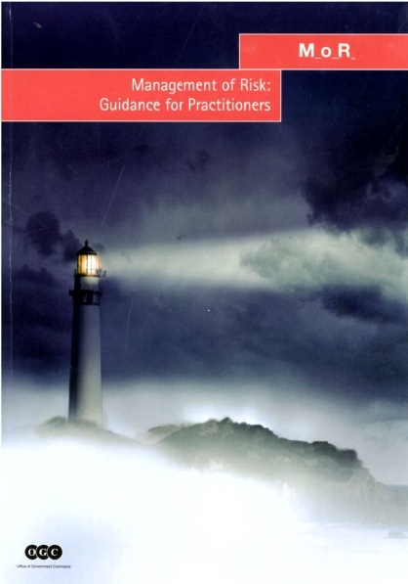
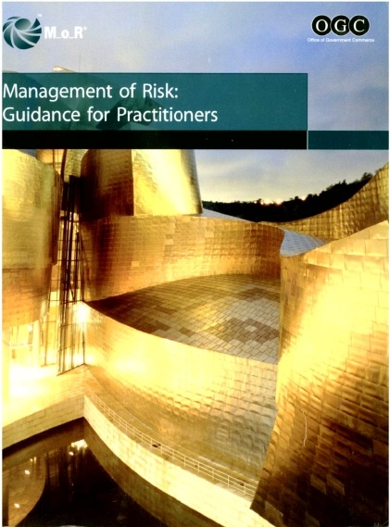
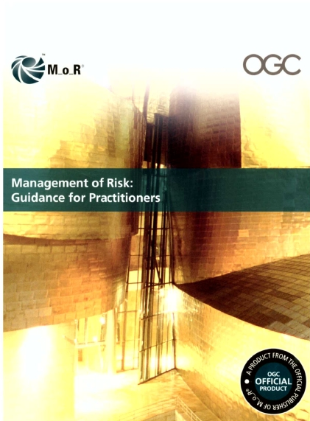
M_o_R History and evolution
Notes:
Pre-history/ successful IT report
2002 edition: 2 covers one version
2007 update
2010 update

Slide 3
M_o_R 2010
Feedback drove the changes:
Principles recast to better align with ISO 31000/BS 31100
Processes unchanged
Some elements in description under “Approaches” moved into process section
The embed and review section has been re-written
Communications described as at the centre of the process.
Notes:
Aligns with objectives fits the context engages stakeholders
Clear guidance informs decision making
allows continual improvement Supportive culture
achieves measurable value

Slide 4
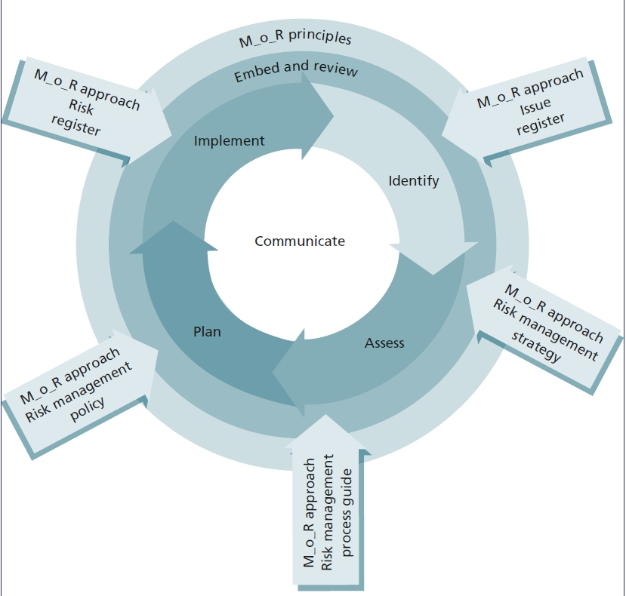
M_o_R Summary

Slide 5
M_o_R Perspectives

Slide 6
Uncertainty is everywhere!
However,
not all uncertainty matters

Slide 7
How does M_o_R help organizations deal with uncertainty?
M_o_R applies a set of principles, an approach and a process to the task of identifying, assessing and controlling risk
This approach:
ensures that the objectives are clearly understood
a wide range of risks are considered – not just the old favourites

Slide 8
Fundamental Questions that M_o_R asks at the start of the risk process:
What is at risk?
Where are the risks coming from?

Slide 9
Question
What is the objective of giving a promotional gift?

Slide 10
Possible Objectives
What is the objective of giving a promotional gift?
Brand awareness
Reward customer loyalty
Promote a change or new product or service
These can be considered to be our objectives
The objectives are at risk and this is what matters

Slide 11
Risk definition
An uncertain event that should it occur will have an effect on the achievement of objectives

Slide 12
Organizational objectives – four perspectives
Strategic
Stakeholder or shareholder expectations
Efficiency, quality and output
Reputation
Strong demand for services
Organization is relevant
Staff have the required skills
Operational
Department reputation
Volume, Cost and Quality
Internal control
Revenue
Staff satisfaction
Customer satisfaction
Programme
Benefits
Capability
Project
Specification
Time
Budget

Slide 13
Where do risks come from?
Many organizations focus on the favourite risks to:
Time
Cost
Quality
This doesn’t help understand where risks are coming from

Slide 14
Question
For the promotional gift, where are the risks coming from?
Note this is not the same as what are the risks!

Slide 15
Suggested risk categories
Economic – Costs /benefits
Reputational – Reflection of company image
Legal – Health and safety, discriminatory, etc.
Environmental – damaging to the environment
Risk areas help us define a better ‘range’ of risks.

Slide 16
Risk Areas – M_o_R tools
PESTLE ANALYSIS
Political
Economic
Social
Technological
Legal
Environmental
Rest of the world
Rest of your organization
Your activity
Stakeholder analysis
SWOT analysis

Slide 17
Linking objectives and causes to form risks
Risk identification relies on:
Understanding what is at risk
What is causing the risk (the risk categories)
Together these will help define a better range of risks

Slide 18
Risk descriptions
Risks are described as a ‘string’ which separates causes, from events from effects
Cause
Event
Effect
What is causing these situation – where are the risks coming from?
What is at risk – what is the impact on objectives?

Slide 19
Summary
Answering two basic questions:
What is at risk
Where are the risks coming from
Helps organizations:
Focus on defining clear objectives
Understand the environmental drivers for risks
Define clear risk descriptions.
For copies of the slides go to the Best Management Practice stand for your free USB stick

