Slide 1
Atern …delivering business solutions…
Notes:
What is Atern?
Atern (the latest version of DSDM - now on Atern v2) is a framework based on best practice and lessons learnt since the early 1990's by DSDM Consortium members. It provides a flexible yet controlled process that can be used to deliver new systems, which combines the most effective use of people's knowledge, tools and techniques such as prototyping to achieve tight project delivery timescales. Time to market is of the essence in most organisations together with robust systems that do not damage their reputation, whether they operate in the public or private sector, in business, education, or any other sphere.
Why choose DSDM Atern?
There is increasing pressure on organisations to deliver working systems to business in ever shorter timescales. The processes by which systems are developed need to be agile and deliver what the business needs when it needs it.

Slide 2
Agenda
The Need for Atern
What is Atern and when can I use it?
Atern – The Philosophy and Principles
Atern – Process, Products and People
Atern – the Techniques
Why choose Atern?
DSDM Atern – The Next Steps
Notes:
About this presentation
Time This presentation can be used for a presentation of anything from 1 to 2.5 hours. There are far too many slides for an hours presentation, especially if you want to take the time for some discussion. So please, depending on the length and goal of your presentation, cut a number of slides out. It could be a good idea to beforehand decide which few slides you will dwell on and which not. So, a WARNING about running out of time if you are doing a short presentation, please manage your time carefully.
The notes Are meant to be used as input to the presenter, hand-outs to the audience, or both.
How to use this presentation There are a couple of ways you may want to use this presentation *Slide show. *Slide show + slides with notes as hand-out.
Contributors Per-Magnus Skoogh, Open World Management, p.m.skoogh@dsdm.org Barbara Roberts, Independent Consultant, b.roberts@dsdm.org
We are more than happy to receive your comments about how to improve this presentation.
Reviewer Jennifer Stapleton, Independent Consultant, j.stapleton@dsdm.org

Slide 3
The Need for “Something”
High proportion of project failures (74%)
Projects do not meet business needs
Projects do not meet financial objectives
People issues
Poor management
Notes:
Some reasons for needing something to help improve status quo
Failed projects Too many projects fail. (Either are not implemented, or are implemented but are not well received, not usable, need major enhancement in order to be usable)
Not meeting business need
Many projects do not deliver what the business needs (although they may actually comply with the specification). Often the business need has changed over time and the specification becomes out of date.
Cost overrun Many projects cost more than planned, either due to overrunning the deadline (increased cost), due to adding people to catch up (increased cost), or by missing a business deadline (increased cost). Any of these circumstances may invalidate the original business case
People issues Delivered solution may be unacceptable to those who actually use it (they generally haven’t been involved until deployment)
Poor management
Keeping to original plan, regardless of circumstances. Avoiding change (often seen as a bad thing, rather than a fact of life in current business circumstances)

Slide 4
Common factors in failures
Poor communication
Not working together effectively
People cause more project failures than technology
Notes:
Some reasons for needing something to help improve status quo
Track record There is a lot of data saying that there is quite a lot of room for improvement for project delivery.
The people thing Most of us are well aware that more projects fail because of people issues than technology. This is why we focus on helping people to work effectively together to achieve the business goals. DSDM is also tool and technique independent enabling it to be used in any business and technical environment without tying the method users to any particular vendor.
The delivery focus There are not many comprehensive frameworks around focusing on time, benefit, people, process, day-to-day management and how to get things done on a daily basis. Most frameworks or methods focus on either high-level decision gateways or lower-level technical details. There is great value in these things, but there is an operational middle ground that is absolutely crucial to project success - how to actually get things done and deliver.

Slide 5
The DSDM Consortium
DSDM facts
DSDM Consortium founded in 1994 – not for profit organisation
DSDM framework based on industry best practice
Latest version of DSDM - Atern - published in 2007
Atern - Free to view and use within your own organisation
Resellers and Accredited Training Organisations must become full members before offering DSDM products and services
Worldwide Consortium membership
Vendors
Small and Medium Enterprises
End Users
Academic Institutions (enabling access for students)
Over 30,000 people trained
Certification programme for Staff, based on mix of theory and experience
Foundation, Practitioner, Trainer, Coach, Lecturer, Examiner, Consultant
Track record of success - 1000’s of successful projects since 1995
Notes:
The History of DSDM
The 16 founding members of the DSDM Consortium met for the first time in January 1994. The organisations had the single objective of jointly developing and promoting an independent RAD framework. At a March meeting of the Consortium, the high level framework was approved by the 36 members unanimously. The basic concepts have remained in place since that time, but the framework has been developed and refined over the life of the Consortium. It has been found to be applicable in nearly every technical and business environment where systems are needed quickly.
Version 1 was completed on time, agreed unanimously by all members of the Consortium in January 1995 and published in February 1995.
To verify the framework in practice, an Early Adopters Programme was launched in parallel with Version 2. As RAD projects are soon complete, the feedback from the Early Adopter Projects together with the work from further Task Groups led to Version 2 being published in December 1995 (three weeks ahead of schedule - but what would you expect from the DSDM Consortium?)
Version 3 was published in October 1997.
The first on-line version, 4.0 was published in 2001.
The current version in use is called Atern and the latest version can be found on www.dsdm.org
The beginnings of DSDM were focused around RAD and IT; however, today DSDM is used across a variety of industries, as a framework to deliver on time solutions, which meet the needs of businesses. The beginning of the Consortium was in the United Kingdom, but now interest can be found through-out the world.

Slide 6
What is Atern?
Atern – the basic concepts
User involvement ensures right business solution
Requirements evolve but timescale is fixed
Early delivery enables early pay-back
Implement the 80/20 rule
Nothing is built perfectly first time
Notes:
The key concepts on which DSDM is built.

Slide 7
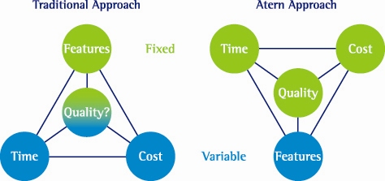
What is Atern?
Notes:
Time-to-market and delivery on-time at all times are key values and principles in DSDM.
Turning the planning paradigm upside down
Today we are often used to delivering all requirements and adding people or calendar time when things go slightly wrong.
In DSDM we will abide by time at all times. This means being ready to throw less important functionality out of the project.
The reasons for time-boxing
Always having the possibility of moving deadlines creates dangerous mind-sets in projects and organisations.
First on the market with new functionality is often the one to make the most money.
Projects are often interdependent. A one week late project often delays several other projects and personnel at least one week too. Each week a 5-person project can thus cost hundreds of thousands in any currency you choose.
Constant re-scheduling of events in projects is very costly in itself and creates disturbances for other parts of the organisation causing further cost there too.
In effect - cutting out functionality is simply much less expensive!

Slide 8
When Can I Use Atern?
Not all projects will be full Atern but….
You can use SOME of Atern ALL of the time
You can use ALL of Atern SOME of the time
The Project Approach Questionnaire helps identify projects where Atern adds most value for least risk
Notes:
The suitability / risk list
To assist management in assessing the risks associated with a given project, DSDM provides a risk identification tool - the Project Approach Questionnaire (PAQ). The PAQ considers the critical success factors for DSDM and characteristics of projects that are especially effective for DSDM. Each potential project should be judged individually using the PAQ. If the project provides a good match against the list, then DSDM can be considered a very appropriate development approach. However, inability to satisfy all of the criteria does not automatically prohibit the use of DSDM, but it will be necessary for risk management strategies to be developed to address any non-compliance.
The criteria included within the DSDM PAQ are intended as guidance material only and should not be considered exclusive. It is expected that an organisation using DSDM will enhance the PAQ with their own specific factors identified from experience of using the method within their environment.

Slide 9
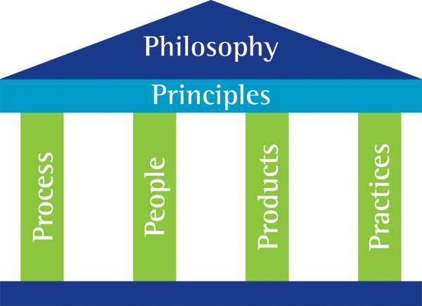
Atern Components
Notes:
The building blocks of Atern

Slide 10
The Atern Philosophy
Projects must be aligned to clearly defined strategic goals, and focus on early delivery of business benefit
To achieve this, key stakeholders
Should understand business objectives
Should be empowered to appropriate level
Collaborate to deliver the right solution
Accept that change is inevitable
Notes:
Philosophy
The philosophy describes the overall objectives for Atern projects. Businesses should set strategic goals and align their projects accordingly. All projects should aim to deliver business benefit early, rather than in a single delivery at the end. This allows an opportunity for early return on investment.
But for this to be successful, key stakeholders need to buy in to the philosophy being adopted through the take-up of Atern.

Slide 11
The Atern Principles
Focus on the business need
2. Deliver on time
3. Collaborate
4. Never compromise on quality
Notes:
Principles (values)
Many organisations use high-level messages, values and culture to guide the overall behaviour of people. In DSDM we use principles to guide us throughout the project. Well understood principles are better guides than detailed process procedures (that no-one follows anyway).
Atern has 8 underlying principles and the complete framework can in most instances be directly derived from these principles.
The principles are based on best practice in its truest sense. These define “the way we do things”.
An Atern project that breaks any one of these principles is in danger of failure, since these are the basic building blocks for Atern, and bind together all the other elements of Atern.
Breaking any of the principles needs to be treated and managed as a risk, but the impact of breaking the principles will always be high. Atern projects should make every attempt to embed these 8 principles into the very fabric of the Atern way of working.

Slide 12
The Atern Principles
5. Build incrementally from firm foundations
6. Develop iteratively
7. Communicate continuously and clearly
8. Demonstrate control
Notes:
Principles (values)
Many organisations use high-level messages, values and culture to guide the overall behaviour of people. In DSDM we use principles to guide us throughout the project. Well understood principles are better guides then detailed process procedures (that no-one follows anyway).
Atern has 8 underlying principles and the complete framework can in most instances be directly derived from these principles.
The principles are based on best practice in its truest sense. These define “the way we do things”.
An Atern project that breaks any one of these principles is in danger of failure, since these are the basic building blocks for Atern, and bind together all the other elements of Atern.

Slide 13
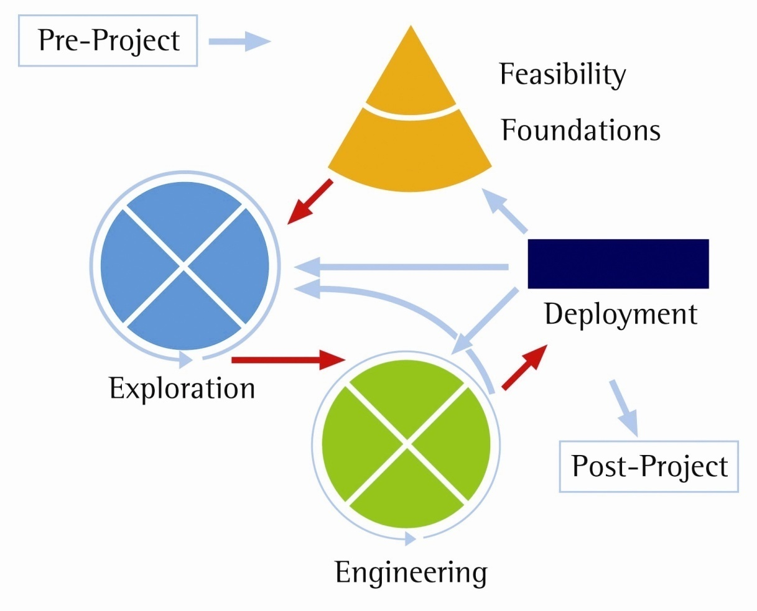
Atern Process – The Lifecycle
Notes:
The Lifecycle
Atern provides a lifecycle for the whole project.
Pre-project is the start / initiation of the project, agreeing the basic Terms of Reference for the work to be done
Feasibility is a short phase to assess the viability and the outline business case (justification) for the project
Foundations is a key phase for ensuring the project is understood and defined well enough so that the scope can be baselined and the technology components and standards agreed, before the hectic development activity begins.
Both Feasibility and Foundations close with a Go/No-go decision, as these are natural points at which to identify and stop projects that, based on the early investigations, are not viable. Stopping at this point, after only limited time/cost should be viewed as a successful outcome (compared to pushing on regardless)
Exploration and Engineering are the iterative development phases where development of the solution happens (within the control of Development Timeboxes).
Deployment happens once for each Increment of the project
Post project closes the project down and assesses the benefits that the project has actually accrued (usually after a few months of the final deployment)

Slide 14
Atern Products
Defined set of products for each lifecycle stage
The system itself (evolving through iterative development)
Planning and management products
Technical products
Quality and review products
Support products
Defined quality criteria for all products
Too many products to cover in this short briefing
Notes:
Products
Discussing the products in detail is out of scope for this presentation.
For each phase Atern defines a number of products to be produced, some examples are:
Prioritised Requirements List - to ensure common understanding and to keep focus on what is important.
Business, Solution, Management Foundations
Plans : Outline Plan, Delivery Plan, Deployment Plan, Timebox Plan
Evolving Solution, Deployed Solution
The products help define the information that is needed to complete one lifecycle phase and move on. Product size will vary depending on the size / complexity of the project.

Slide 15
Atern People - Roles
Notes:
People working together effectively is the foundation of any successful project. Atern recognises this and assigns clear roles and responsibilities to each person in a project, both from the customer and supplier side of the project. These two communities work very closely together in Atern projects - there is no "us and them".
Communication is key to making people work well together. Many of the principles and techniques in Atern, such as workshops, role definitions (including communication paths) and user involvement play a big part in ensuring good communication throughout the project.
Management & Leadership in Atern is open, objectives-based and hands-off from detailed planning (but a lot of regular monitoring and risk elimination). There is an anti-fault philosophy where we try to find solutions to problems rather than figuring out who is to blame. Team members are given objectives to fulfil rather than activities or tasks to do.
Team dynamics. Teams are managed by objectives and are self directing. Teams and individuals make their own plans of tasks to achieve the defined objectives (deliverables / products). Solution Developers are producing complete signed-off results (e.g. for an IT project, this includes analysis, design, coding, testing, documentation, user input, etc and not just “programming”.) Communication within the team is key to success and techniques such as putting the team in the same room and having a daily meeting are frequently used.

Slide 16
Atern Techniques
DSDM defines 5 core techniques…
Iterative Development
Timeboxing
MoSCoW Prioritisation
Facilitated Workshops
Modelling
Notes:
Core techniques
There are some very core techniques that are used in Atern to achieve success. These can be thought of as intellectual tools or method components.

Slide 17
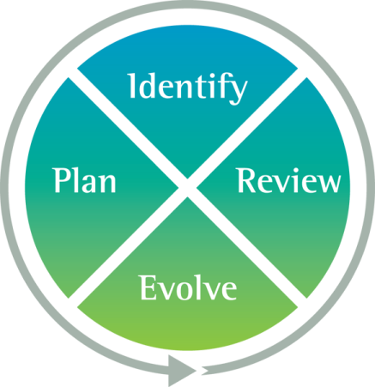
Iterative Development
Allows evolution from high level concepts to delivered product
Three perspectives…
Functional
Usability
Non functional
Development cycles for Exploration and Engineering…
Notes:
Iterative Development
This approach allows teams to evolve the solution from high level ideas to the delivered product
Iterative development follows a fundamental cycle of Identify, Plan, Evolve, Review. This builds feedback into the development process, but at the same time it ensures that iterative development is controlled.
Functional perspective - demonstrates how a specific business objective has been achieved by the evolutionary step
Usability perspective – demonstrates how the user of the solution interacts with it to achieve the business objective
Non-functional perspective - demonstrates how general issues related to, for example performance, capacity, maintainability have been accommodated

Slide 18
MoSCoW Prioritisation
Must Have
Requirements fundamental to solution
Defines Minimum Usable Subset – basic working solution
Should Have
Requirements important to system
Measured in terms of value or impact
Could Have
Can do without in the short term
Won’t have this time
Will wait till later
Notes:
MoSCoW
MoSCoW is simply a pragmatic way of doing prioritisation that has proven effective in real projects. Of course there are more advanced ways, but MoSCoW has proven surprisingly effective. MoSCoW is, however, not an excuse to avoid doing a correct estimation! One of the main benefits of letting MoSCoW play a key part in the project is forcing a discussion about what is really important.
The levels
Must-have. Projects often get too many must-haves. Identifying the real must-haves is key to success. A simple way is to ask the question “if you do not get this, should we still continue the project?”. If the answer is yes - it is NOT a must-have. Aim is for about 60% Must Haves (i.e. 60% effort)
Should-have. Not getting a should-have will hurt a lot, but there are workarounds, even though they may be cumbersome and irritating.
Could-have. Valuable requirements with a clear business case but we can do without them.
(Should and Could haves make up the remaining 40% effort)
Won’t have this time. Legitimate requirements that we, for now, leave for later increments / phases of this project.

Slide 19
MoSCoW Prioritisation
Why prioritise?
Not enough time to do everything
Not enough resources to do everything
Lack of money or lack of people (or both)
MoSCoW means important things are done first
Musts and Shoulds often deliver 80% of total business benefit
MoSCoW priorities drive sequence of delivery
Target is effort split 60% Must Have, 40% Shoulds and Coulds
Predictable and sustainable delivery
Notes:
MoSCoW
Prioritising ensures that projects deliver the maximum value. Focus stays on the important aspects
The balance should be 60% Must Have effort, 40% Shoulds and Coulds. The reason for this split is to ensure predictability – the Must Haves are always delivery (unless compete disaster strikes), and the business should be able to bank on having at least the Must Haves (the Minimum Usable Subset). But they should also expect the Shoulds and, hopefully, some Could Haves. Solution Developers do not complete the Must Haves and then sit back!

Slide 20
Timeboxing
Achieves defined objectives by a fixed deadline
Leverages MoSCoW
Maintains focus on on-time delivery – every time
Manages dependencies within a project
Enables regular assessment of real progress
Prevents scope creep
Notes:
Timeboxing
Timeboxing is a very important aspect of Atern projects. Without timeboxing, project teams can lose their focus and run out of control. Timeboxing is a process by which defined objectives are reached at a pre-determined and immovable date through continuous prioritisation and flexing of requirements using the MoSCoW rules.
A timebox will produce something visible in order for progress and quality to be assessed. Examples of what such a timebox could deliver include a part of the Functional Model, a partial system component or an early version of the solution. All necessary reviews and tests are contained within the timebox, otherwise it will be difficult to fit any necessary rework or change into subsequent timeboxes.
Timeboxes work through the effective application of empowerment. The team working in the Development Timebox must agree the objectives and the Solution developers and Solution testers must themselves estimate the time required. At the deadline, the Business Ambassador must be able to approve the delivery of the products covered by the timebox. If it appears that deadlines could be missed, the deliverable should be de-scoped dropping the lower priority items, i.e. Should Have and Could Have requirements can slip and timing never does. Continuous negotiation of what is important is at the team level.
Development Timeboxes are Atern’s way of being in control of the project and these follow the process as shown above. If the Development Timeboxes are working, then above that, the Increment Timebox is on track, and above that, the Project Timebox is also on track. Increment and Project Timeboxes do not necessarily follow the Investigate, Refine, Consolidate process.

Slide 21
Facilitated Workshops
Facilitated workshops are…
“A team based approach to communication”
“Using an interactive workshop environment, effective group dynamics and visual aids, facilitated sessions are designed to extract high quality information in a compressed time frame, to meet a predetermined set of deliverables.”
Notes:
Workshops Workshops are used throughout the project for resolving issues. Workshops are structured and have clear deliverables.
Workshops can, for example, be used for:
*Defining requirements (MoSCoW list). *Business analysis (process & work-flow models, etc). *Solution design. *User interface design. *Problem solving. *Project planning. *Review & re-planning.
Documentation & Communication Documentation is not about communication of understanding. A document is not very good at conveying a true understanding. It is at the workshops and other human-contact meetings where we learn, discuss and truly understand the problem domain. Documents are then excellent tools for writing down facts, figures and other information for our collective memory.

Slide 22
Facilitated Workshops
Used throughout Atern to achieve…
Speed
Decisions made in days, not months
Ownership
All stakeholders present
Productivity
Ideas born and grown quickly
Overall perspective
Wider involvement of participants possible
Consensus
Agreement and acceptance from empowered stakeholders
Quality decision making
All parties hearing the same information
Notes:
Workshops 2
Further benefits to be gained by using workshop techniques in your projects.

Slide 23
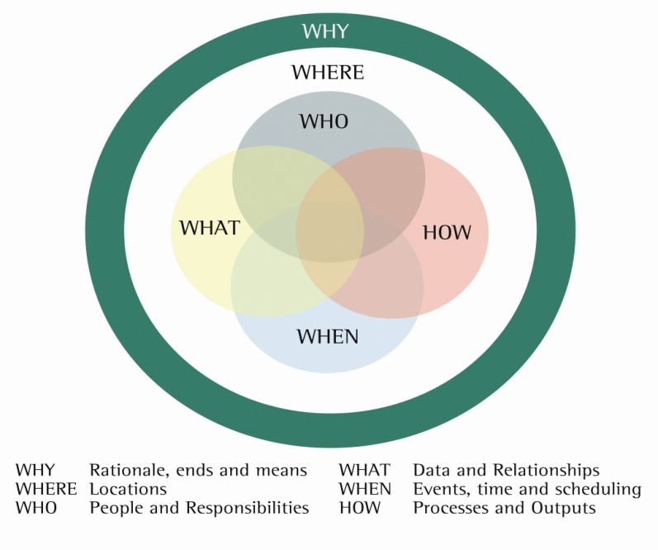
Modelling
Powerful
Improves communication through shared visualisation
Models deployed according to project needs
Atern advocates standard industry techniques…
Selected to your organisation’s requirements
Enough to satisfy the purpose – no more
Notes:
Modelling
When requirements are vague, as they almost always are, it is more or less impossible to build something perfectly the first time. Atern recognises this and uses it to an advantage.
Not just Atern recognises this, but so do a lot of other organisations. Some examples are:
*Amtrak builds train models in soap. *Tram vendors build real size driver environments in paper to evaluate the “feel” for where the various controls should be. *Internet start-ups (those still around) may quickly put a site up to get early evaluation and feedback from prospective users. *Architects build mini-models of new buildings.
In other words, many organisations recognise that writing a specification and then “just do it” just does not work. Instead, careful elaboration and controlled evolution is necessary.

Slide 24
Why Choose Atern?
Management
Track record of On Time and In Budget delivery
“Corporate strength” agile
Highlights failing projects early
Provides a common language
Business & Users
Ownership of solution
Ability to drive direction of project for optimum business benefit
Delivery of a working solution on time, every time
Provides a common language
Project Manager
Objectives-based
Clearly defined process with regular review points
Provides a common language
Effective planning
Appropriate formality
Developers
Responsibility
Growth opportunities
User involvement
Provides a common language
Notes:
The reasons may differ depending on the role you have within the organisation.
Management Management chooses Atern because it promises (and delivers) projects on time and on budget. If not enough of Atern is used (risks are too high) or the project is not set-up correctly, the timeboxing techniques give early warning of failures to come. Any seasoned manager will appreciate knowing about a problem 3 months before delivery, rather than two days after.
The Project Manager The objectives-minded PM chooses Atern because it helps him/her set, break down and distribute objectives within the project and its teams. He/she also likes the reviews within the timeboxes because this allows the projects to spot mistakes while they are being made, rather than afterwards when it is too late.
The Solution Developer chooses Atern because it treats him/her like an accomplished adult and lets him/her take full responsibility for a complete signed-off deliverable. This means wider responsibility, growth opportunities and a more rewarding job.
The Users The users choose Atern because is allows them to control development while it is happening. They realise that most projects do new things and nothing can be produced correctly the first time and therefore constant feedback and involvement is required to ensure they get what they need.
Other roles QA because of frequent validation. Operations because of early involvement. Method & process because a process is easily explained (even though not as easily executed).

Slide 25
Meets business needs
Targeted expenditure
Faster delivery (enables early payback)
User involvement and commitment
Solutions that are “fit for purpose” – they meet the business need
“The system delivered less than we asked for, but more than we expected because we got exactly what we wanted (needed).” Dave Thompson, Shell Expro

Slide 26
DSDM (Atern) Productivity
Source: Study Commissioned by Xansa: 7 Year Longitudinal study
Notes:
More information on this study available at http://www.dsdm.org/kss/details.asp?fileid=405

Slide 27
Delivery Time
18-24
11
87%
77%
5
4-6
Average time to delivery
(in months)
Average project
team size
% of completed projects
rated good to excellent
Using traditional approaches
Using Atern
Source: British Airways IM Department, Newcastle
Notes:
A comparison with traditional methods across the whole IT system portfolio – mainframe, client/server, small pc systems, PL/1, Notes, Business Objects, Oracle, CICS, DB2, and Access.

Slide 28
Why Choose Atern?
What business demands from IT….
Deliver solutions on time
Deliver solutions in budget
Deliver working solutions of good quality
Atern can satisfy the business demands
Notes:
Some further reasons for choosing Atern can be
*It is relatively simple to understand (logically - actually changing your ways may be difficult). Developers through to upper management can have a common language and view of how things get done in your organisation.
*Vendor independent.
*Up and running relatively quickly, with a little help.
*Not very expensive.
*Interfaces well to tollgate & control models such as Prince2, PMI, etc.
*Interfaces well to developer focused models such as XP.
*It is proven and successful in real life projects.
*Several different measurements have shown a good positive return on investment. (It is well worth the money you spend on it).
*It has a focus on areas which really matter for project success: Objectives, people, communication, time and business.
Proven track record of interfacing with :-
Atern and Prince 2
Atern and ISO / CMMI quality
Atern and XP

Slide 29
Atern - Next Steps
What is needed for Atern success…
Common understanding of Atern and acceptance of the Atern philosophy
Trained Atern people
Strong “Pragmatic style” project management
User buy-in, commitment and involvement
Management commitment
A team environment and appropriate resources
Key use of Atern techniques
Notes:
Before embarking on Atern it is important to make sure that key success factors are in place (or can be put into place).

Slide 30
DSDM Consortium - Next Steps
Need more facts about using Atern in your organisation?
Free Publications available via www.dsdm.org
DSDM Atern e-book
Some DSDM White Papers
Atern training may help with this. Contact a DSDM Consortium Accredited Training Organisation
Atern handbook, Atern pocketbook, Estimating in Atern pocketbook
Consider getting external independent Atern advice
Ask for independently Certified DSDM people
Accurate knowledge
Proven track record of success
If unsure, confirm DSDM credentials of external advisors with Consortium
Pilot an Atern project in-house
Notes:
This is a simple example of how to get started on your first DSDM Atern Project. Further and more detailed guidance is available in the DSDM Manual. To get a couple of projects up and running does not have to be difficult or lengthy (but the level of commitment must be high). To make DSDM a deeply ingrained part of your organisation will, of course, take a longer time.

Slide 31
DSDM Consortium - Membership
For Resellers
A Full Reseller Licence
If your organisation is marketing DSDM / Atern related products or services you must be a licensed reseller. All licensed resellers are listed on the website, the first place anyone looking for DSDM / Atern related services is likely to visit. In addition, resellers are entitled to discounts on many Consortium products, services and events.
For End Users/Government/ Academic/NGO’s
End user membership
Provides unlimited access to all the products and services, discounts on publications and events as well as access to the community for support and advice.
Notes:
To get access to all this and more contact the DSDM Consortium and become a member.
Or, for access to some of this, register on the site and you will receive information on what is going on within the DSDM Consortium.
.

Slide 32
DSDM Consortium – Extras
Consortium Membership Benefits include…
A copy of the Atern handbook and each pocketbook
Access to the interactive version of Atern created using the Eclipse Method Composer from the Eclipse Foundation
Access to all Templates: Delivered in Word or Excel format for ease of use
All White Papers: The Consortium continues to draw on the experience and expertise of its members both end users and resellers and disseminates their knowledge through a series of
White Papers.
20% discount on all items in the Webshop. All publications and reduced entry fees to events such as the Agile Business Conference and Roadshows. The Consortium also negotiates on behalf of members for discounts on partner organisation events.
Support and Advice: As part of your membership we will put you in touch with other members. Contact the Consortium if you have a question and we will endeavour to help you find the answer.
20% Reduction for Exams: Members receive a discount on all certificates.
Notes:
To get access to all this and more contact the DSDM Consortium and become a member.
Or, for access to some of this, register on the site and you will receive information on what is going on within the DSDM Consortium.
.

Slide 33
Questions?
www.dsdm.org
info@dsdm.org
DSDM and Atern are registered trade marks of
Dynamic Systems Development Method Limited
Notes:
Further questions
Please contact the DSDM Consortium for further information and answers to all your questions.

